Slide 1

Determination of Ochratoxin in Raisins Through NIR Scan with AI Based Methods
by
Ali Baki TÜRKÖZ
Approved by Asst. Prof. Dr. İpek BAZ
Faculty of Engineering
Department of Electrical and Electronics Engineering
Istanbul, 2024

Slide 2
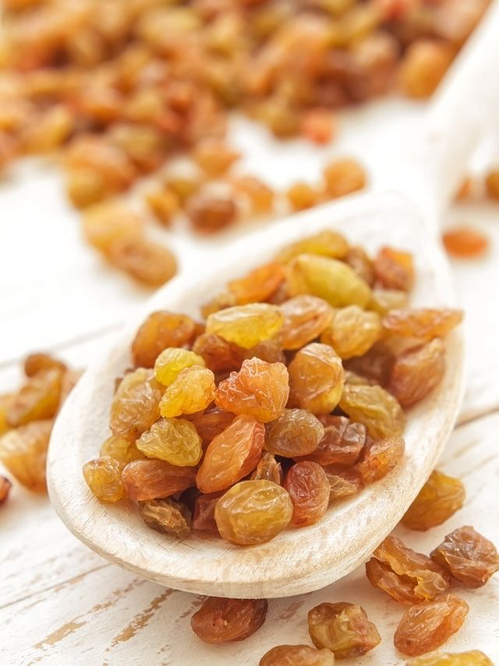
Welcome to the presentation of my project on the determination of ochratoxin in raisins.
Credit: Pinterest/Moneycontrol India

Slide 3
Determination of Ochratoxin in Raisins Through NIR Scan with AI Based Methods
Introduction
Raisins, highly sensitive to fungal development, are frequently contaminated by Ochratoxin A (OTA), a carcinogenic and toxic mycotoxin. Given Türkiye's significant role in global raisin production and export, controlling OTA contamination is crucial for public health and the economy. Current OTA detection methods, like HPLC and ELISA, are time-consuming, inefficient, and inadequate for large-scale inspection. This study aims to develop a faster, more reliable AI-based detection system using NIR Spectroscopy to identify and predict mycotoxin presence in raisins, improving product safety and quality. Periodic screening and advanced detection methods are essential to maintain international demand and prevent economic losses from contaminated exports.
Abstract
Raisins (Vitis vinifera) are widely consumed food, but mycotoxin contamination, particularly by Ochratoxin A (OTA), poses a serious health threat. OTA, prevalent in grapes and grape products, has carcinogenic, teratogenic, immunotoxic, and neurotoxic effects, potentially causing kidney diseases and cancer. The International Agency for Research on Cancer (IARC) classifies OTA as a probable human carcinogen. Türkiye, a major player in raisin production and export, faces significant challenges with OTA contamination, endangering both human health and the Turkish raisin industry. Therefore, it is crucial to detect and control OTA in raisins.

Slide 4
Literature Review
Previous studies indicate a lack of innovative AI-based systems for detecting ochratoxin in dried grapes, relying instead on chemical analyses. For instance, the presence of Ochratoxin A (OTA) in grapes sold in Istanbul was determined using reverse-phase high-performance liquid chromatography (HPLC) after extraction and purification with immunoaffinity columns.
Other studies analyzed samples from İzmir, Aydın, and Manisa for mold and OTA presence using HPLC methods. Analytical techniques such as HPLC and liquid chromatography with fluorescence detection (LC/FLD) are commonly used for OTA detection due to their convenience, sensitivity, and lower detection limits.
Alternative methods include thin-layer chromatography (TLC), gas chromatography-mass spectrometry (GC-MS), capillary electrophoresis with laser-induced fluorescence, and enzyme immunoassays (EIA). LC/FLD remains the preferred method for its economic and sensitive detection capabilities.

Slide 5
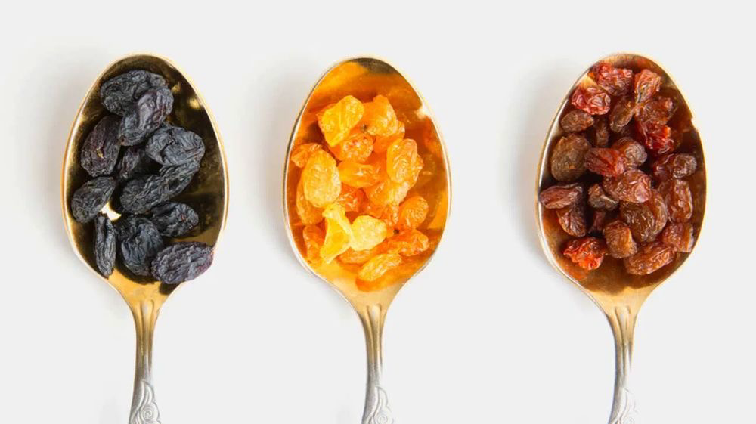
Goals and objectives
Creating a Reliable Data Set
Developing a Model Succesfully
Testing the Model on Raspberry Pi
Writing a Thesis on this Project
Credit: Pinterest/Healthline

Slide 6
TIME LINE
Literature Search and Data Collecting
Algorithm Selection and Design
Beginning the Code
Exprement and Thesis Phase
Final Report Delivery

Slide 7
01
02
03
Ochratoxin
Spectrometer
CNN
Ochratoxin A (OTA) is a mycotoxin. This toxin is carcinogenic to rodents. It is teratogenic, immunotoxic, and likely neurotoxic and genotoxic. Additionally, it has been shown to be the cause of urinary tract tumors in humans. It leads to kidney diseases and cancer in humans. Ochratoxin A was classified as a possible human carcinogen (Group 2B) by the International Agency for Research on Cancer (IARC) in 1993
A spectrometer captures spectral information invisible to the human eye, and types like NIR, MIR, and FIR detect different wavelengths. Spectral cameras have been chosen, and convolutional neural network-based models are trained with spectral images to detect OTA in -raisins. Reasoning for the choice of NIR:
Non- Destructive analysis, Speed and Efficiency, Depth of Penetration, Minimal Sample Preparation, Sensitivity to Organic Compounds
Convolutional Neural Networks (CNNs) are deep learning models that analyze and learn from images by applying convolutions to detect changes and calculate gradients. They consist of multiple layers that transform input data into output, with fewer parameters than traditional neural networks, allowing for more complex tasks. CNNs are highly effective in image classification, detecting features from simple edges to complex patterns, and include models like AlexNet, VGG, GoogLeNet, ResNet, EfficientNet, and MobileNet.

Slide 8

Methods
Convolutional Neural Networks
CNNs or Convolutional Neural Networks are specialized artificial neural network models for image analysis and detect changes through convolution and gradient calculations; It is especially suitable for image classification, allowing to perform complex tasks with larger models by transforming the input with fewer parameters. Popular models include AlexNet, VGG, GoogLeNet, ResNet, EfficientNet and MobileNet.
​Layers of a Convolutional Neural Network
CNN is comprised of various layers, including convolutional, non-linearity, pooling, and fully connected layers, where convolutional and fully connected layers possess parameters, while pooling and non-linearity layers do not, showcasing exceptional performance in machine learning tasks, especially in image-related applications such as computer vision and natural language processing (NLP), with remarkable outcomes observed, exemplified by the significant ImageNet dataset.
Activation Functions
Activation functions are essential in deep learning, aiding in information passage, preventing overfitting, and enhancing accuracy, but their selection is crucial, and they must possess key attributes like non-linearity and differentiability, with integration into the backpropagation algorithm being vital for accurate model updates.
Classification
Classification in machine learning involves categorizing dataset instances into predefined classes, with applications across various fields like medicine, engineering, finance, and marketing, typically falling into binary or multi-class categories; algorithms like KNN, Naïve Bayes, decision trees, SVM, and ANN are commonly used, selected based on dataset features and problem characteristics; while classification offers benefits like data organization and decision-making support, challenges such as poor data quality and model interpretability must be addressed, with ongoing research areas like deep learning and transfer learning driving improvements.
Credit: Pinterest/Forbes

Slide 9
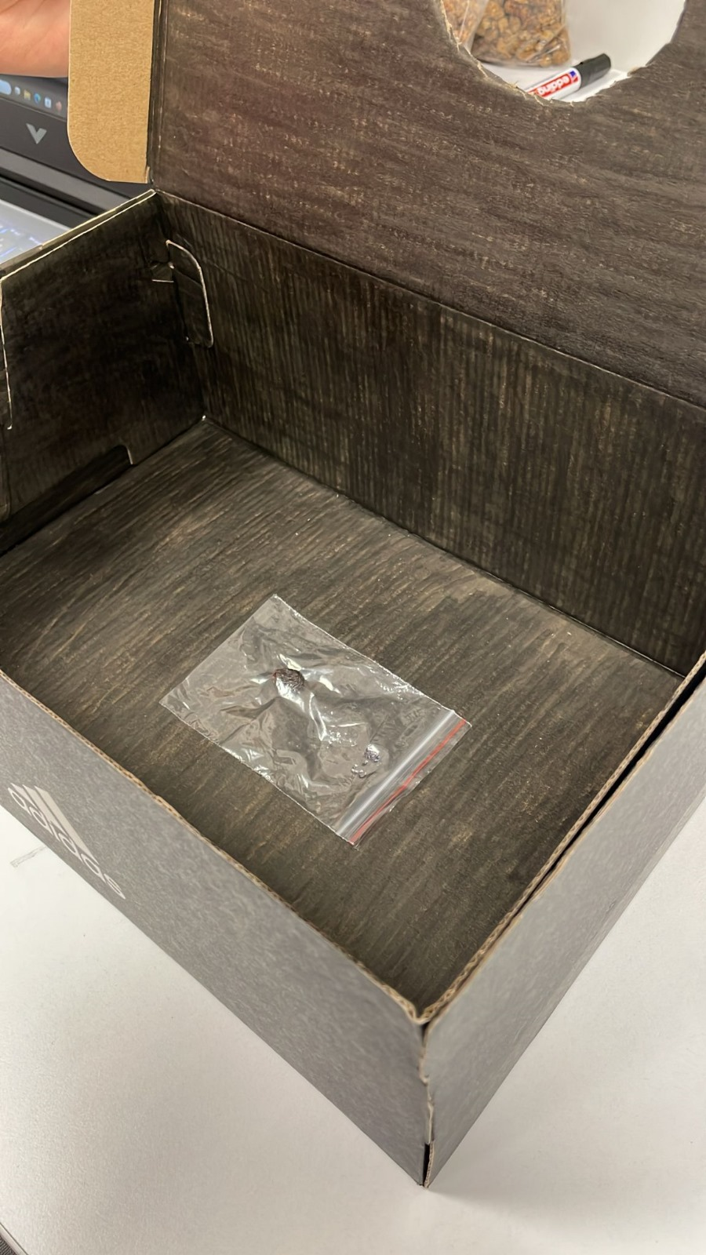
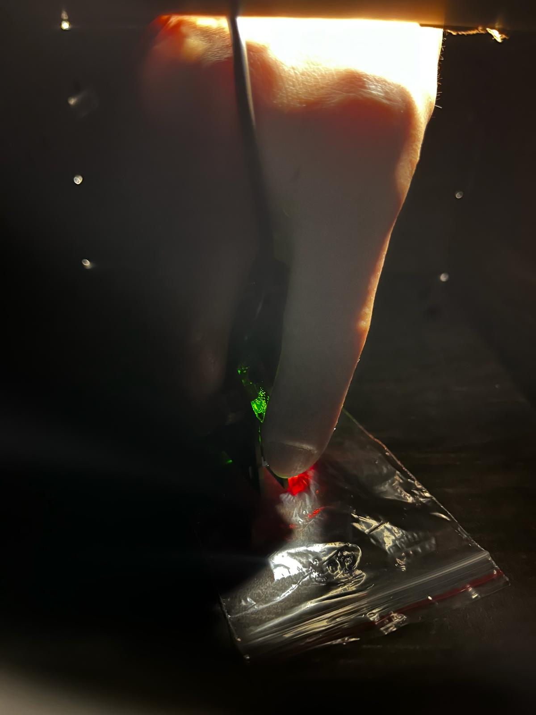
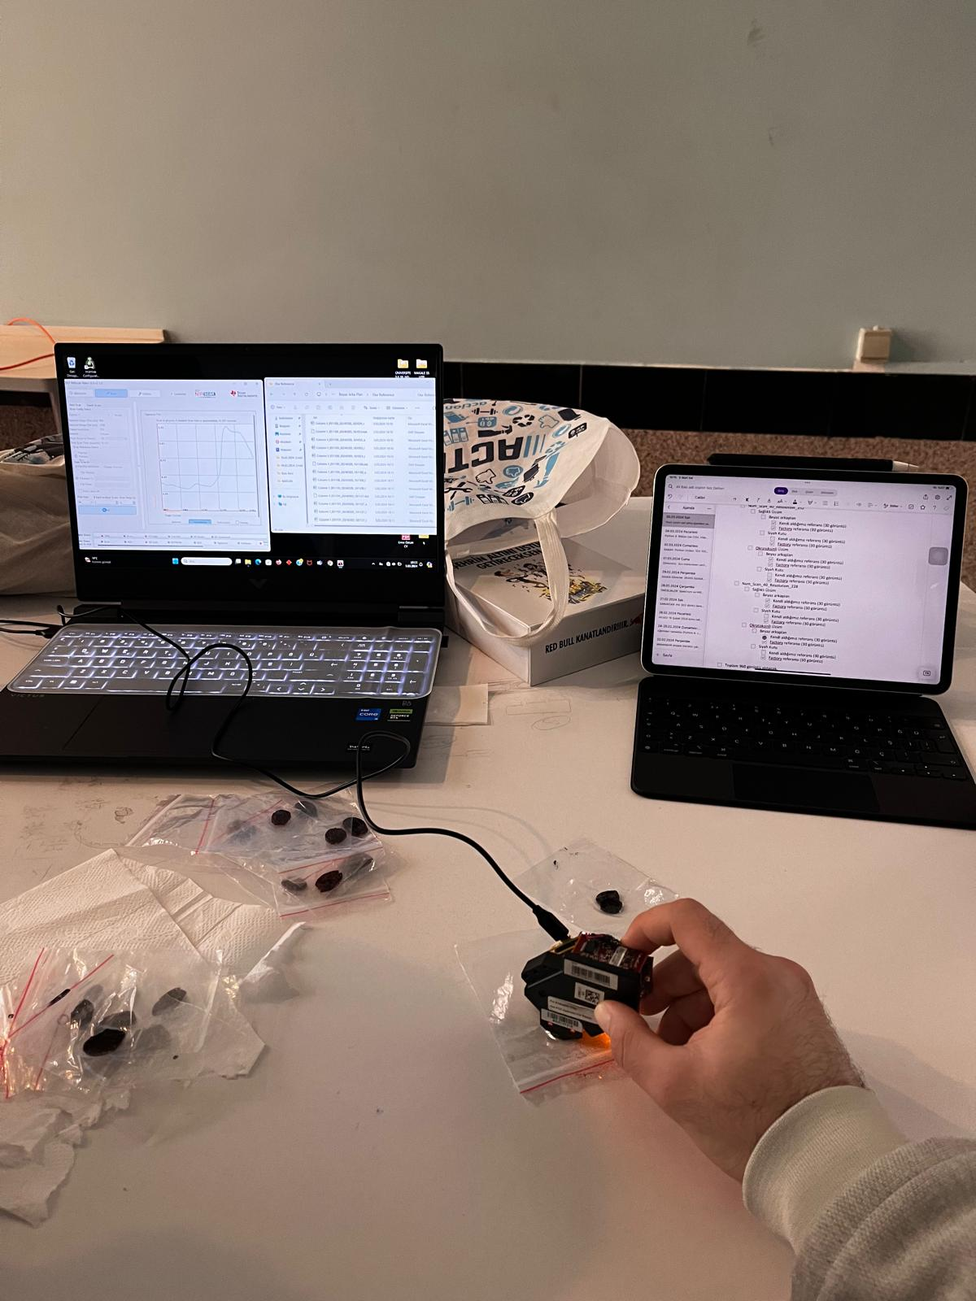
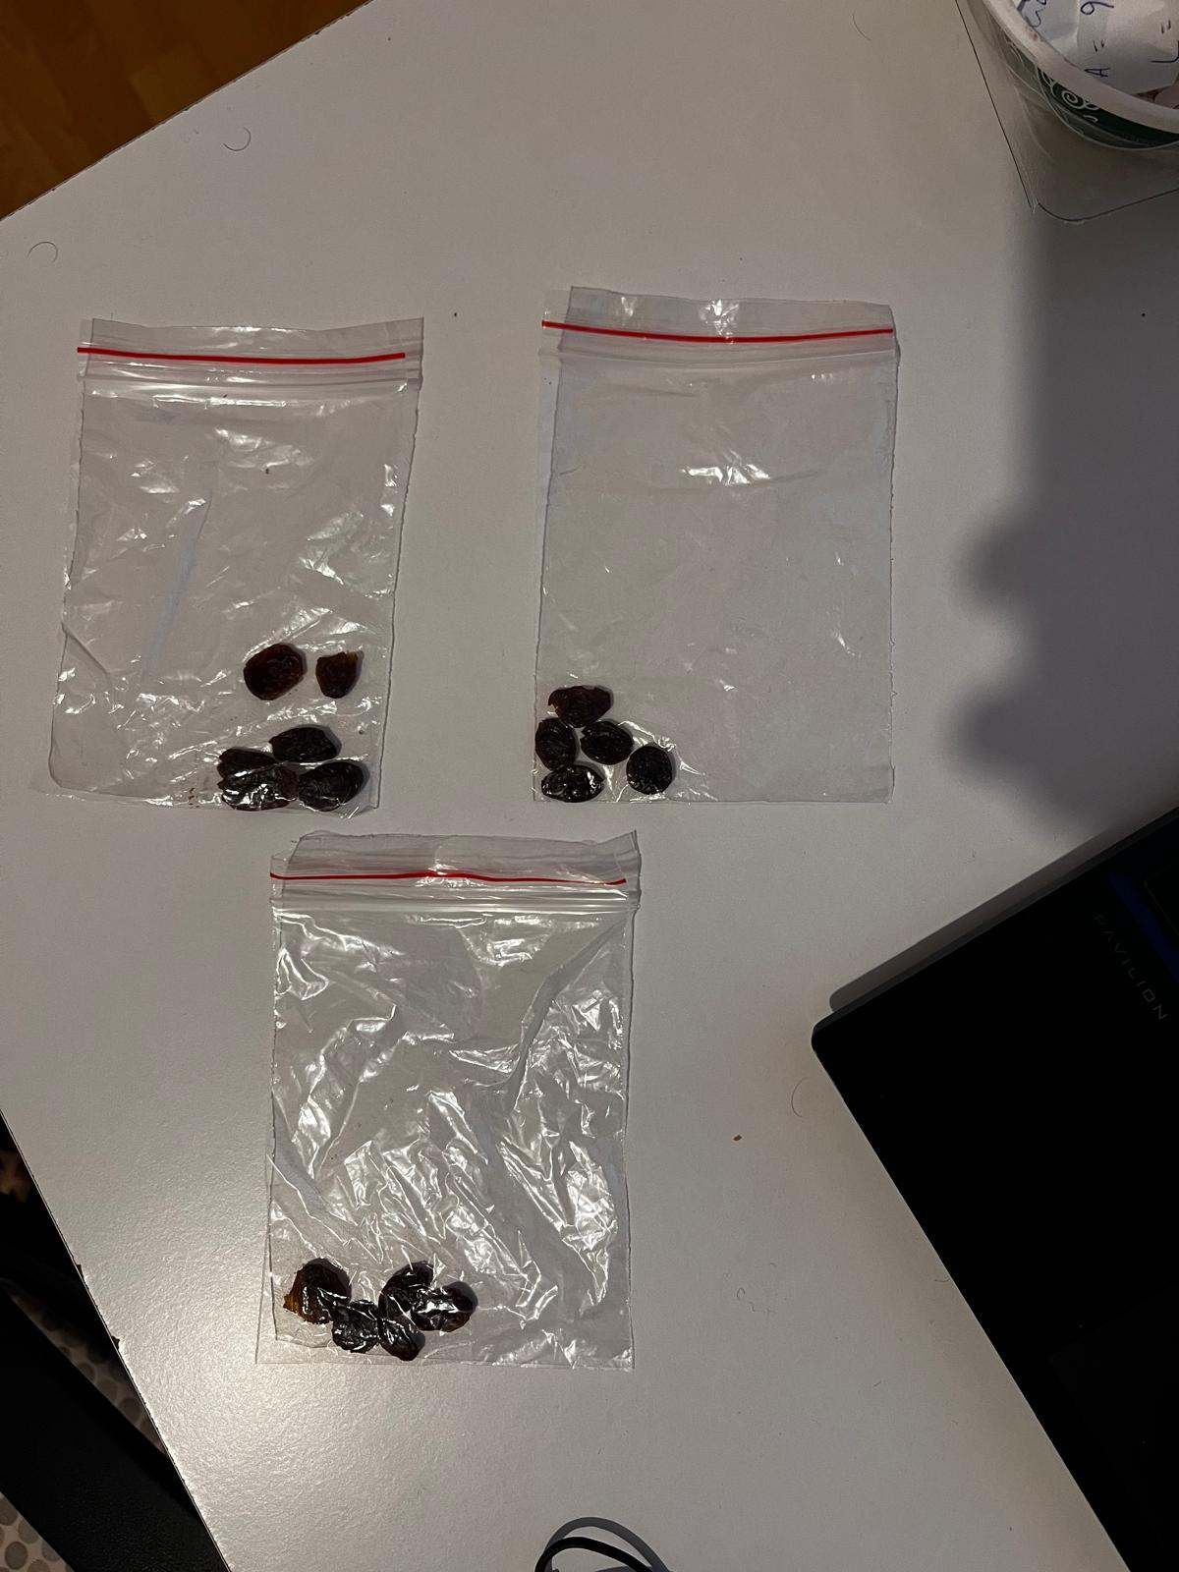
Data Collection Trials
Sample Preparation: Ochratoxin-contaminated and healthy raisins were individually sealed in transparent plastic bags in a sterile environment. Strict hygiene rules were followed to avoid contamination and ensure accurate data, including the use of masks and surgical gloves.
Data Collection Environment Trials: Different data collection environments were tested, including a white background and a closed black box. The inside of the shoe box was painted black with white board pen for the experiments. In addition that different NIR Spectrometer settings was tried. After these trials, it was decided that the black closed box and 40 number of scan and 228 digital resolution for NIR Spectroscopy provided a more reliable data set.

Slide 10
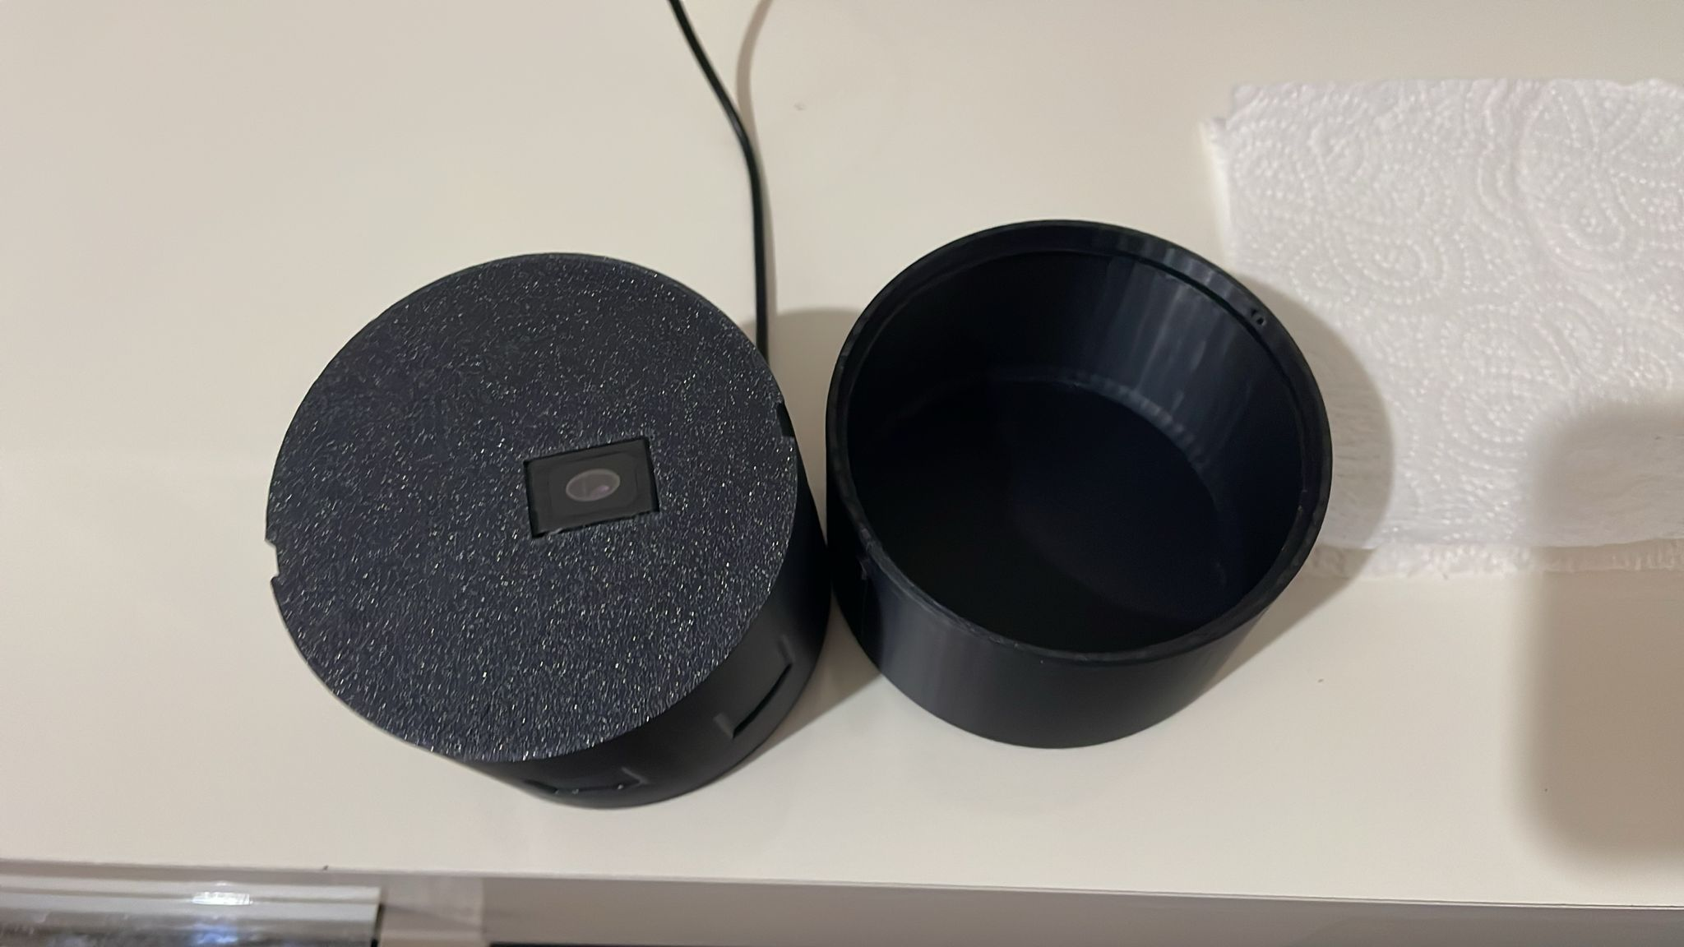
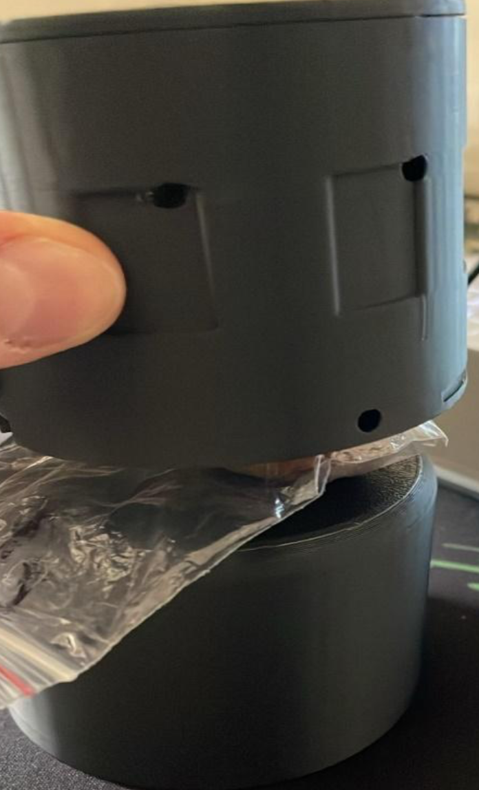
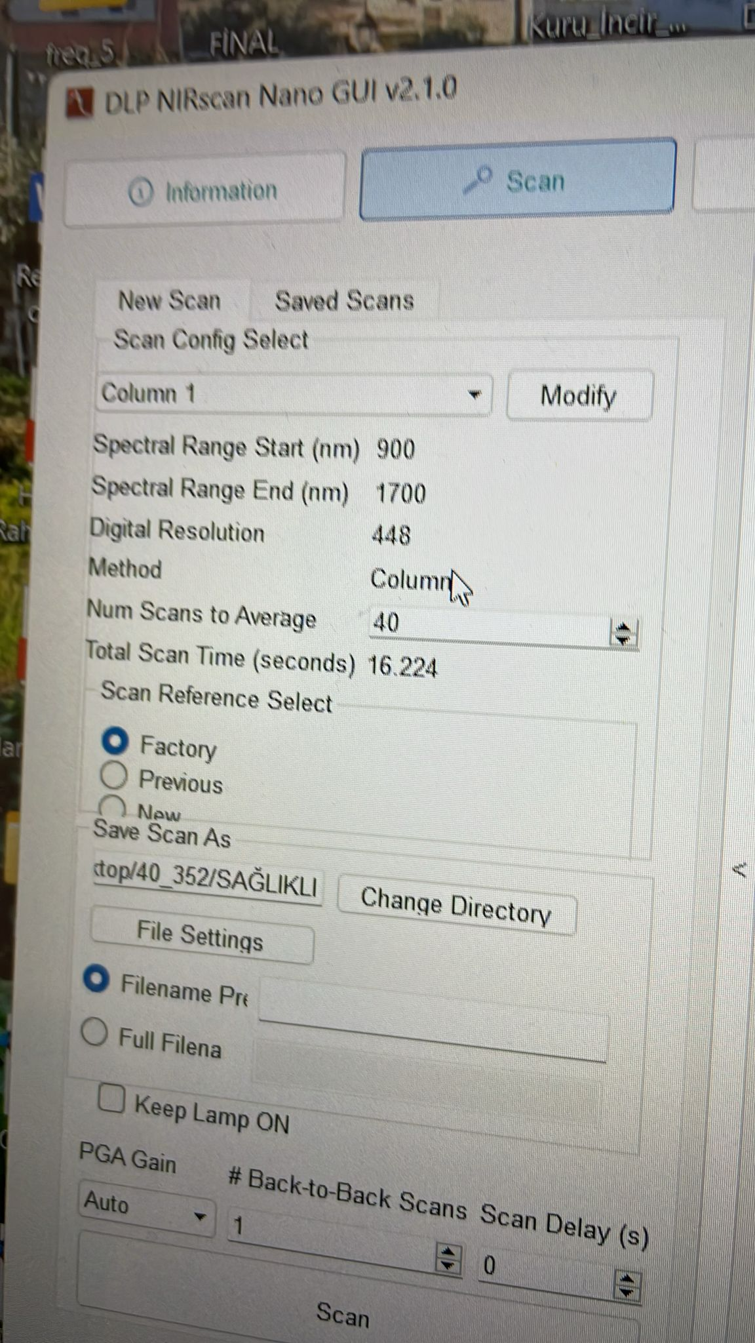
Data Collection
Custom Black Box Design: It was determined that using a black closed box yielded healthier results. Therefore, a specially designed box was created to prevent light from entering, ensuring a stable environment for data collection. Raisins were placed in a plastic bag, pressed on the sensor, and the box was closed to collect data in a light-free environment.
Spectral Data Collection: Spectral data of the packaged raisins were collected using a DLP NIR SCAN NANO spectrometer within a wavelength range of 900-1700 nm, with 40 scans and 228 digital resolution settings (Figure 5.2). The spectrometer was placed in contact with the raisins through the plastic bags, and two back-to-front data readings were obtained from each raisin, resulting in 700 data points from 350 raisins per class, totaling 1400 data points from 700 raisins for both classes

Slide 11
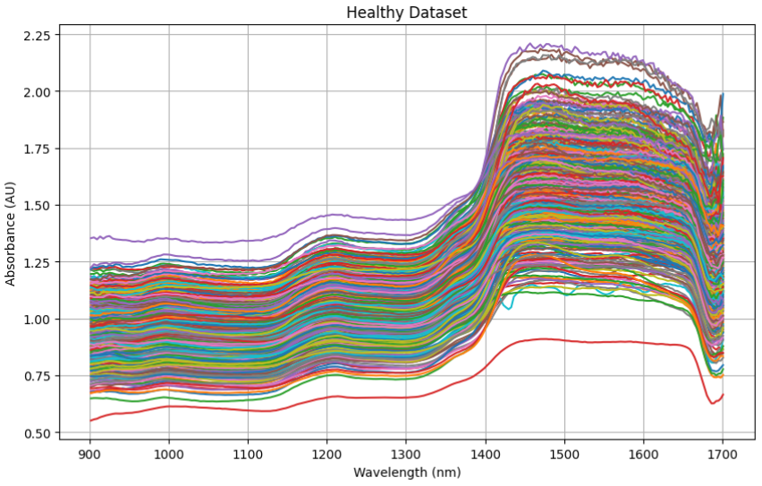
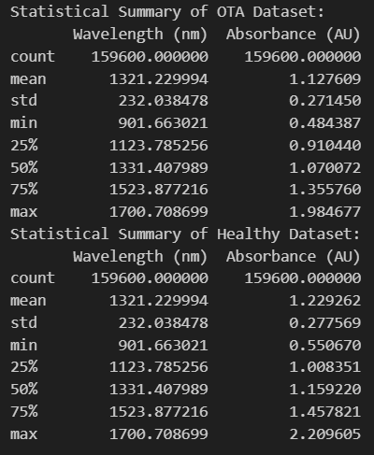
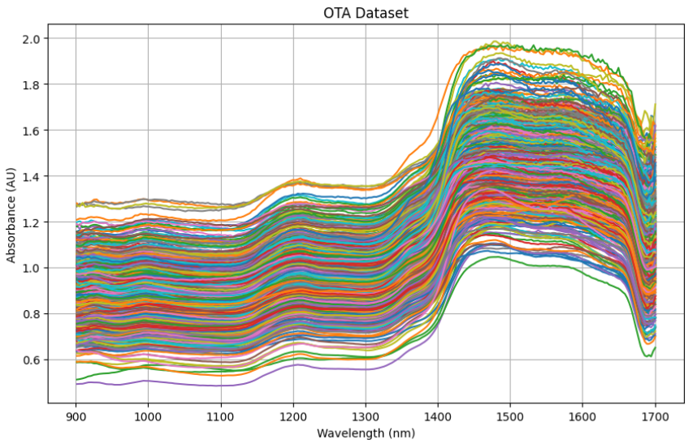
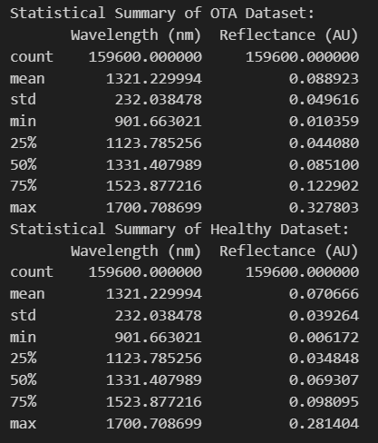
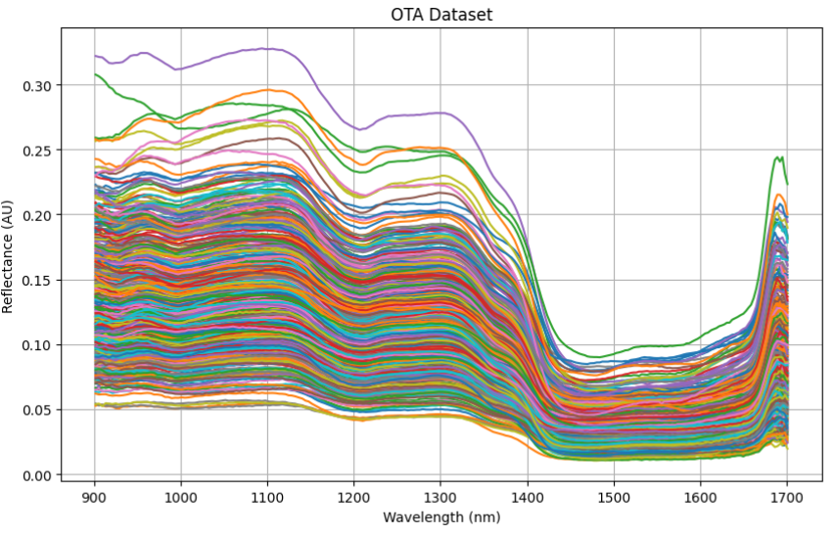
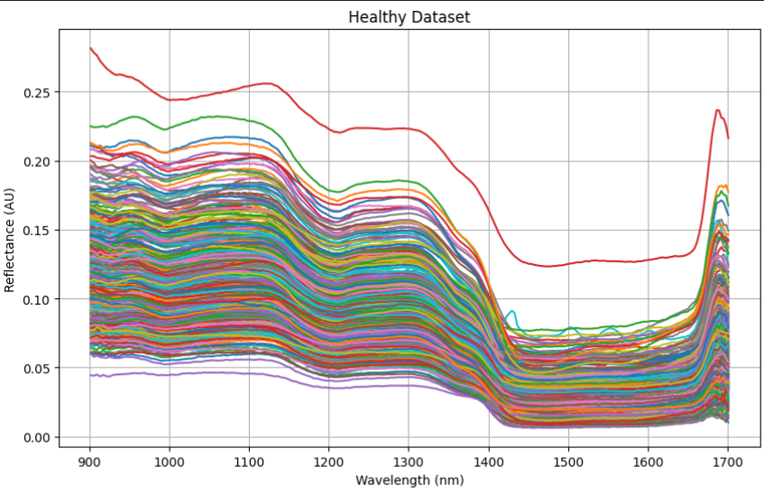
Data Analysis

Slide 12
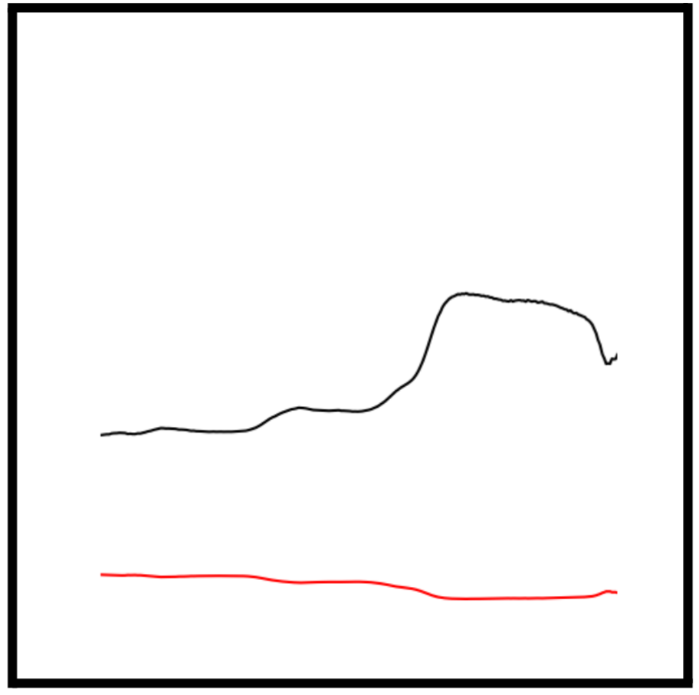
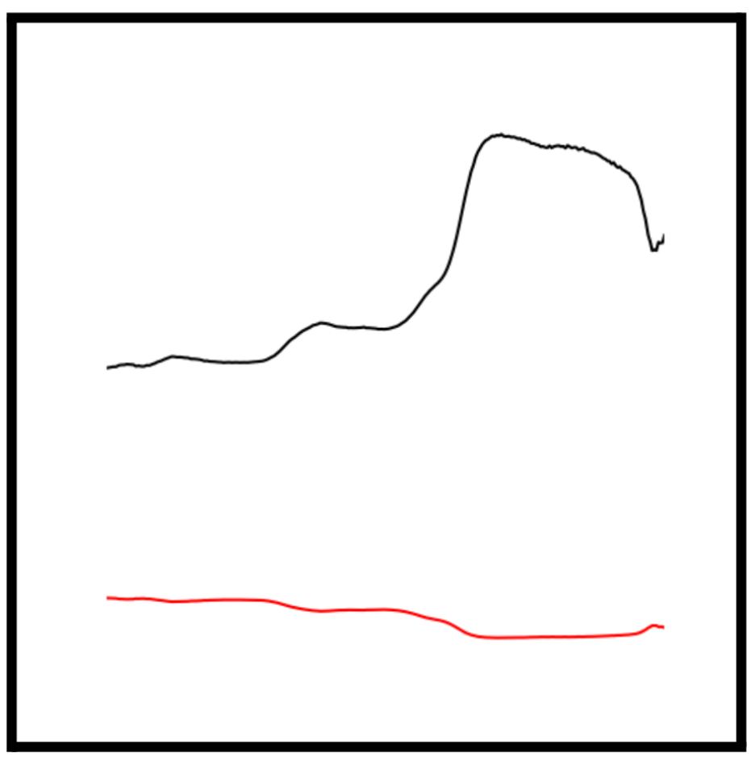
Dataset CSV to PNG Coverting
The .CSV files from the dataset were converted into .PNG image files with dimensions of 512x512 pixels. Each image contained both absorbance and reflectance data for each measurement. This conversion allowed the observation of the changes in absorbance and reflectance in a single image.
Two types of plots were generated:
* Plots with no axis limitations (Unlimited Graph)
Plots with fixed axis limitations: Y-axis range of 0-2.5 AU and X-axis range of 900-1700 nm (Limited Graph)
Limited Graph
Unlimited Graph

Slide 13
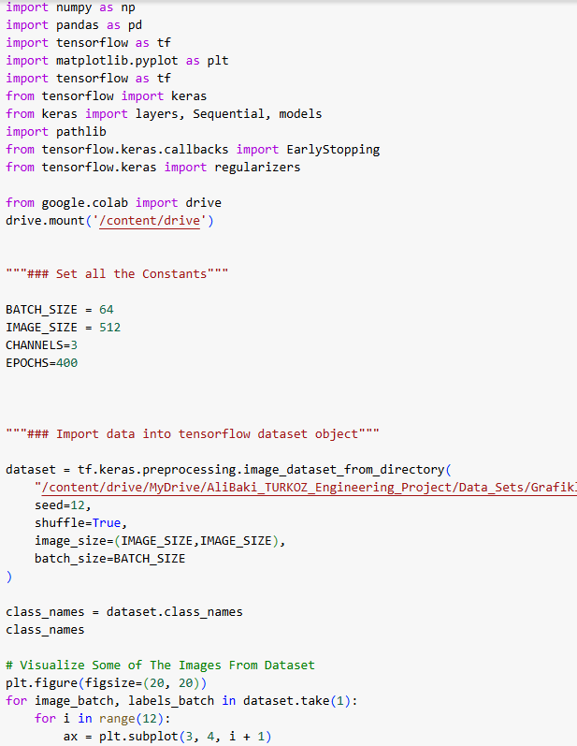
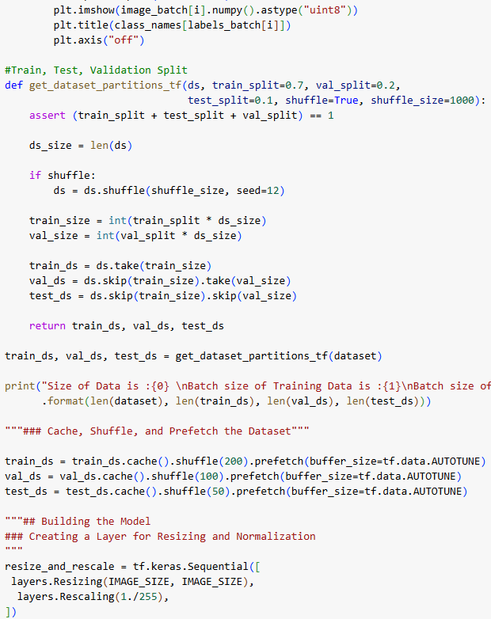
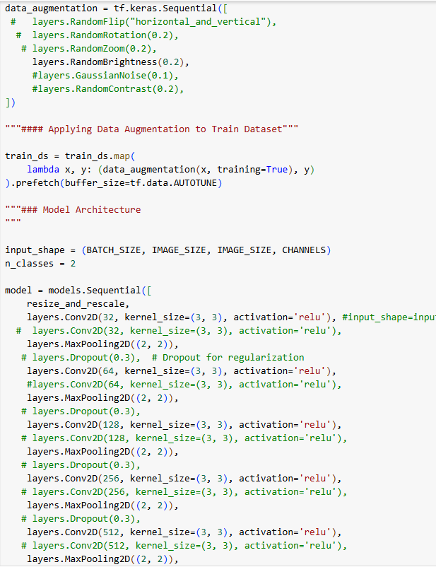
CNN Code

Slide 14
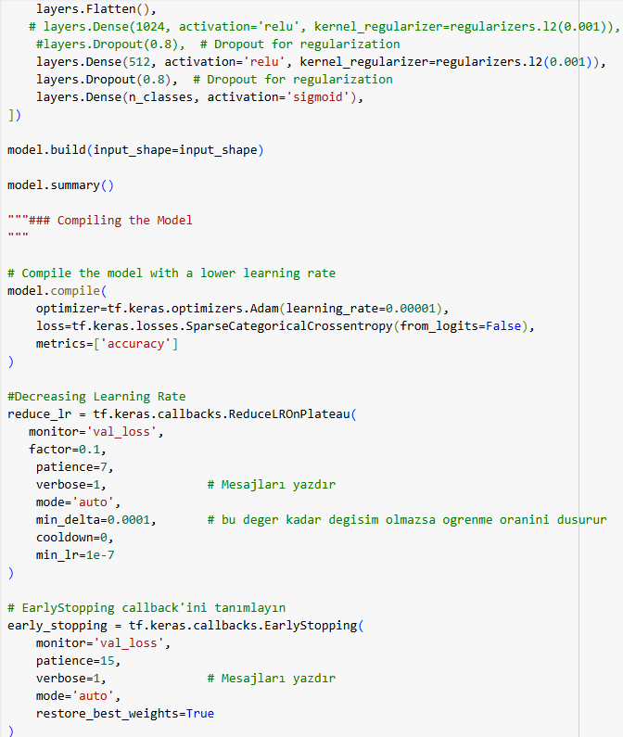
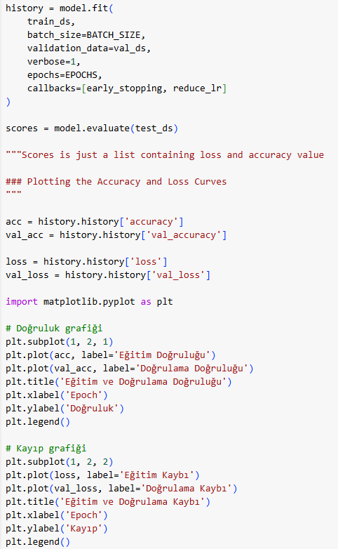
CNN Code
L2 and Dropout Regularization: Techniques to prevent overfitting by penalizing large weights and randomly deactivating neurons during training.
Data Augmentation: Method to increase dataset diversity by applying random transformations to input samples.
Normalization: Preprocessing step that scales pixel values to a standardized range, ensuring uniform data distribution.
CNN Layers: Convolutional and pooling layers for feature extraction and spatial downsampling in image analysis tasks.
Dense Layers: Fully connected layers responsible for end-to-end learning and mapping features to output classes.
Callbacks: Utility functions like EarlyStopping and ReduceLROnPlateau to monitor and adaptively adjust model behavior during training.
SparseCategoricalCrossentropy: Loss function used for multi-class classification tasks, measuring the discrepancy between predicted and actual class probabilities.
Shuffle and Seed: Parameters for shuffling dataset to ensure randomness while maintaining reproducibility.
Prefetch and Buffer: Optimizations to preload data into memory, improving training throughput by mitigating I/O bottlenecks.

Slide 15
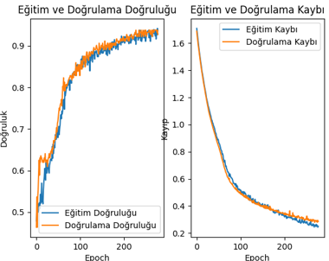
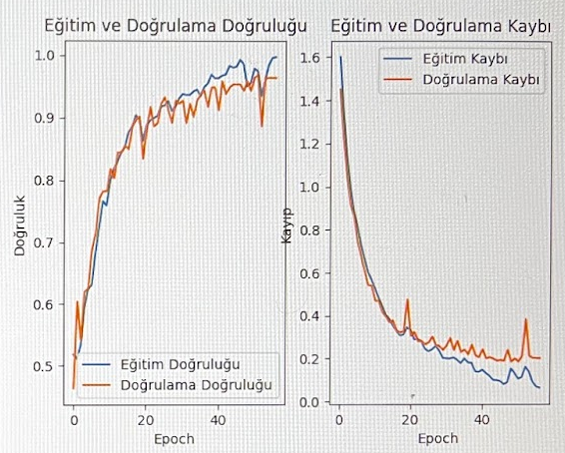
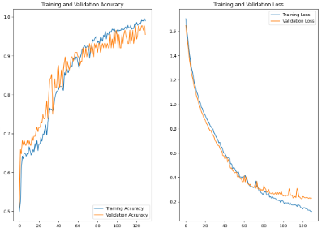
Training Results
Training Accuracy = %92.71
Training Loss = %23.67
Test Accuracy = %83.75
Training Accuracy = %96.88
Training Loss = %12.64
Test Accuracy = %85.5
Training Accuracy = %97.73
Training Loss = %17.94
Test Accuracy = %84.5

Slide 16
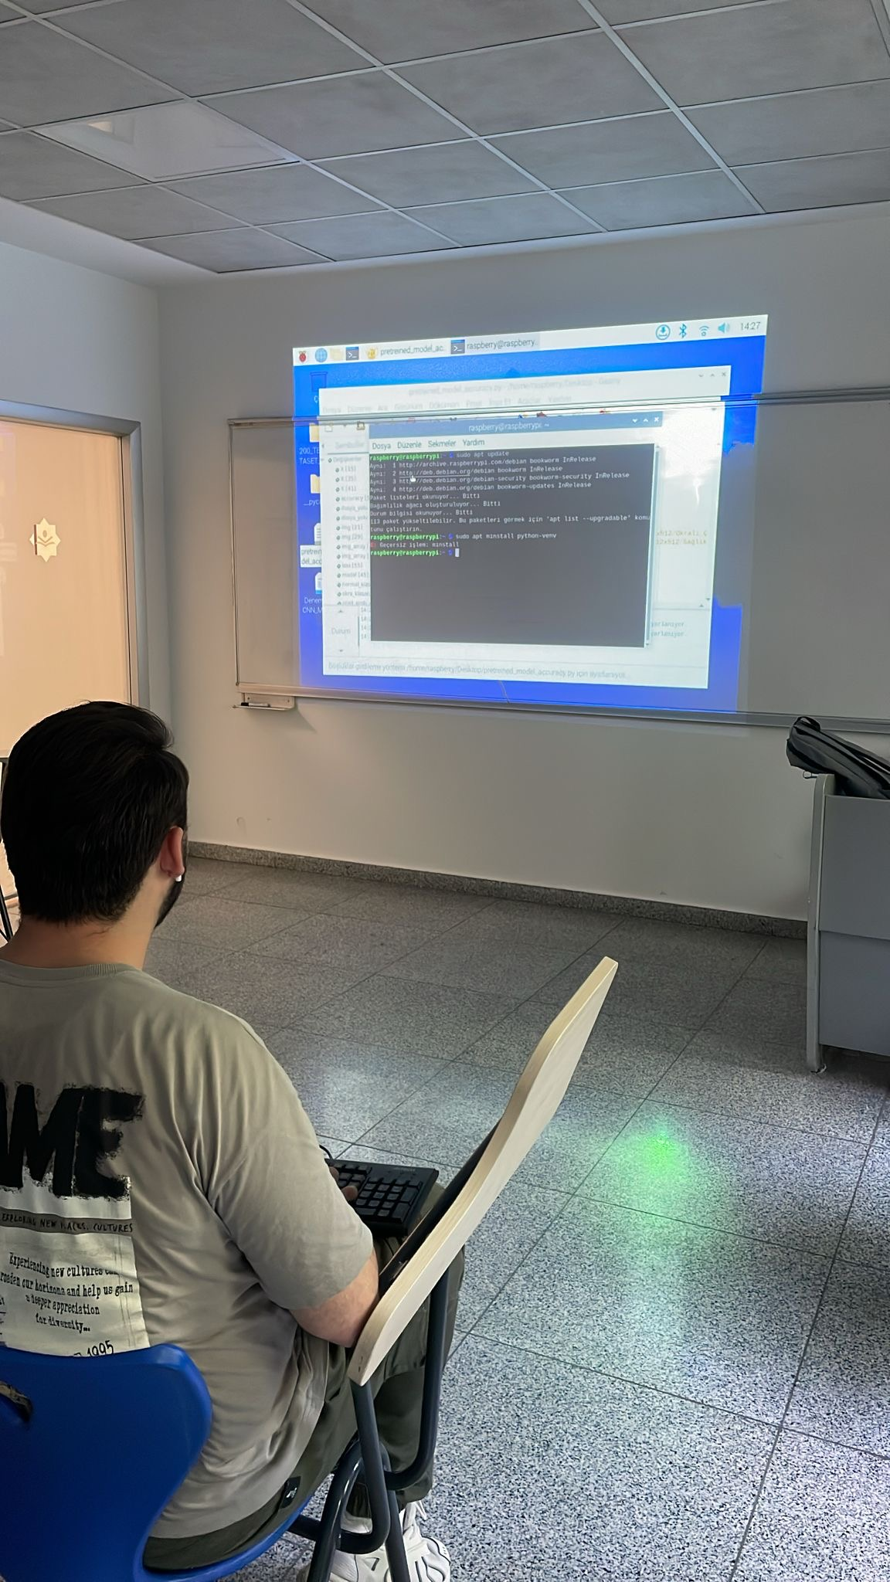
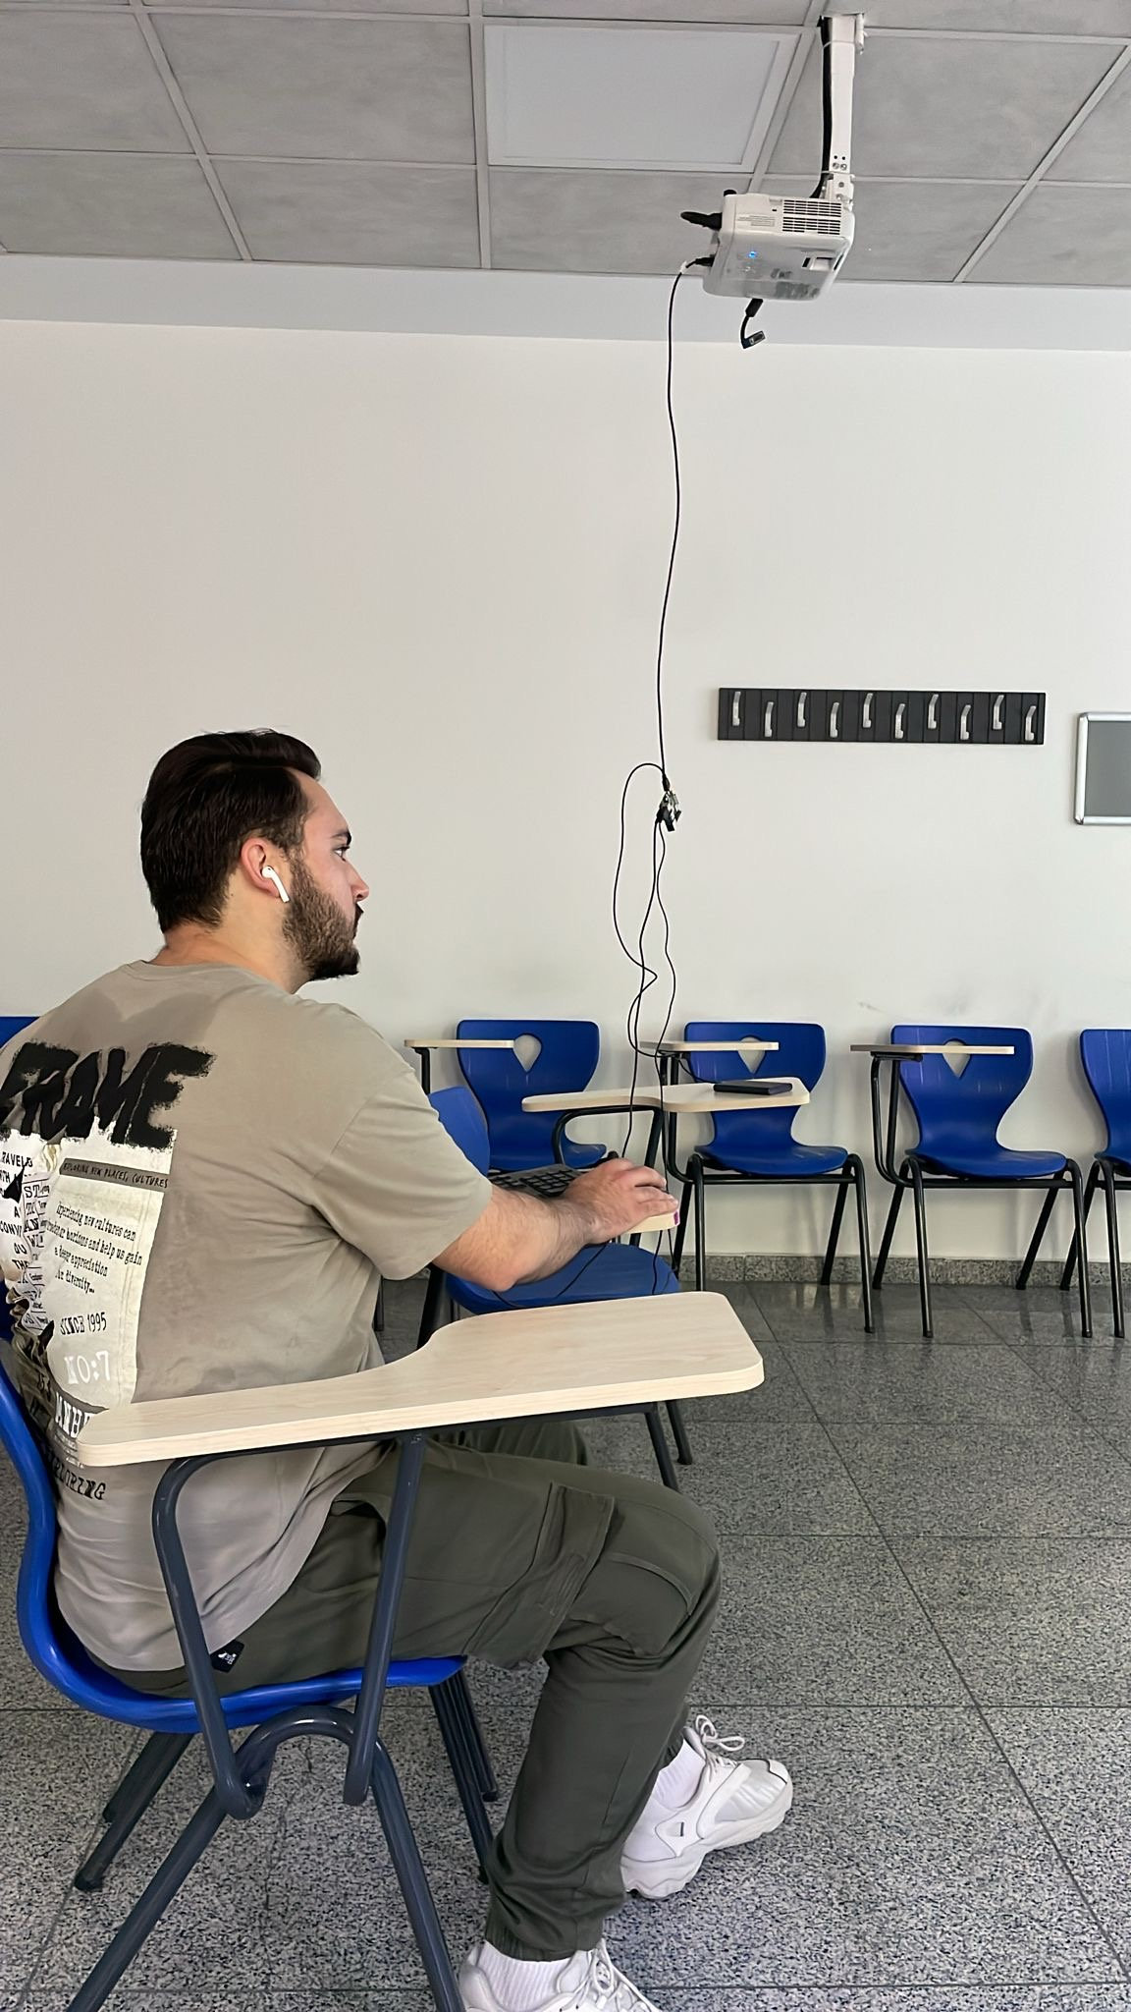
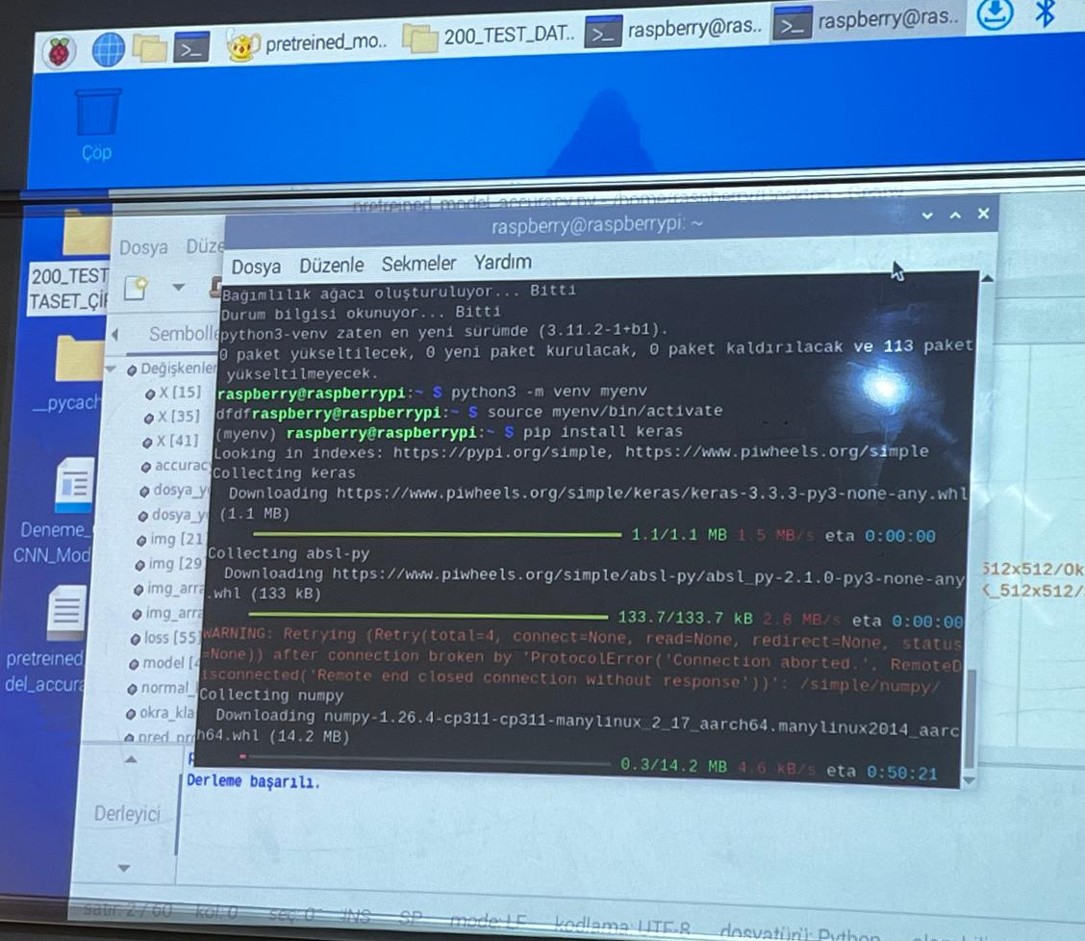
Raspberry Pi Setting Up

Slide 17
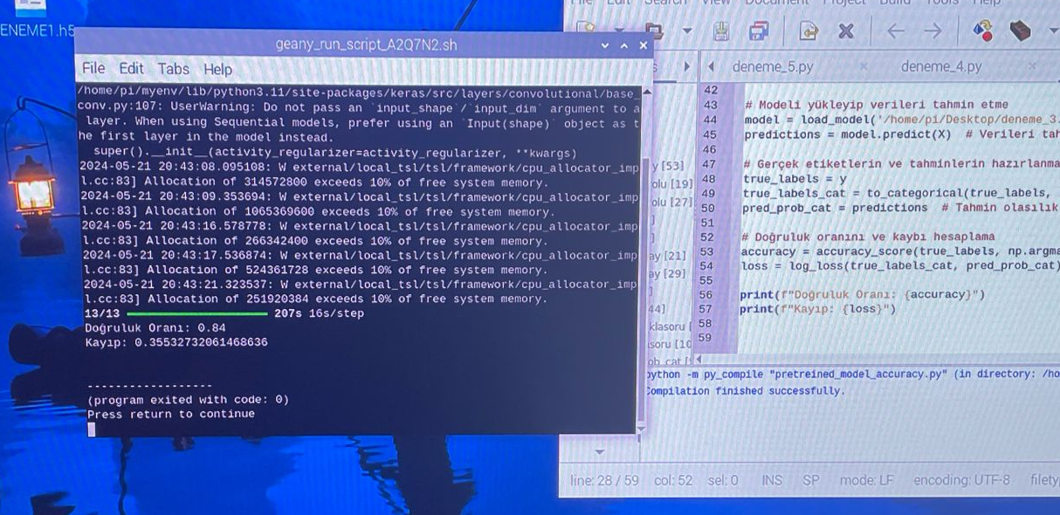
Raspberry Pi Test Result

Slide 18
Reach Goals
01
A reliable data set was created (1400 data sets).
02
A model with up to 98% training and 85% testing accuracy was developed.
03
The model was successfully tested on raspberry pi with the test data set.
04
A Thesis was Written on the Subject

Slide 19
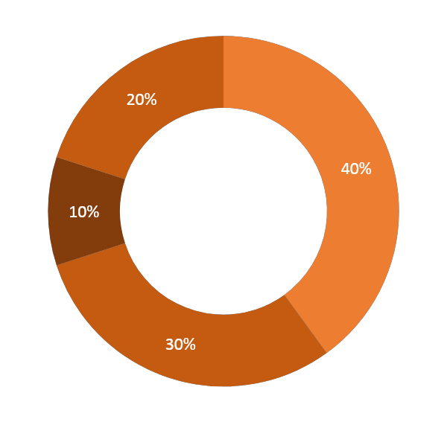
CONCLUSION
This study used spectral analysis and machine learning techniques to classify raisins contaminated with ochratoxin versus healthy ones. Results showed a significant spectral difference, with contaminated raisins having lower absorbance rates, indicating that spectral analysis could effectively detect ochratoxin. A custom-designed CNN model achieved the highest accuracy, outperforming standard models. The model was successfully integrated into a Raspberry Pi, proving the feasibility of using a low-cost, portable device for field detection. Future research should use larger datasets, compare different models, and explore spectral analysis for other foods. These findings represent a significant advancement in food safety and ochratoxin detection methods.

Slide 20
Thank You For Listening

